Slide 1
ALCOHOL DETECTOR
Submitted by
KAVIYA R S-191EC187
SNEHA T- 191EC275
POORVASANTHIYA S- 191EC229
NIVEDHA O N- 191EC222

Slide 2
INTRODUCTION
The main purpose of this project is to reduce traffic accident cases based on driving under the influence of alcohol.
The alcohol sensor used in this project is MQ-3 sensor to detect the presence of alcohol content in human breath.
The whole system can be employed in any steering wheel equipped motor vehicle.
This system senses the alcohol molecules present in a specific range and if found, fails the attempt of the driver to start the engine.

Slide 3
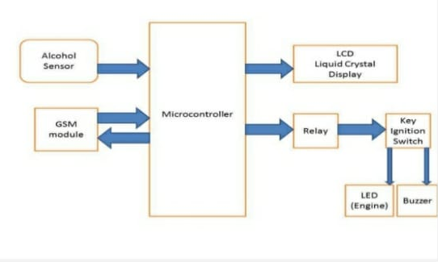
Block diagram

Slide 4
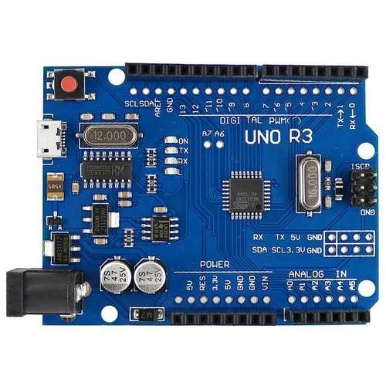
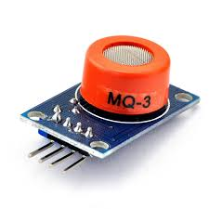
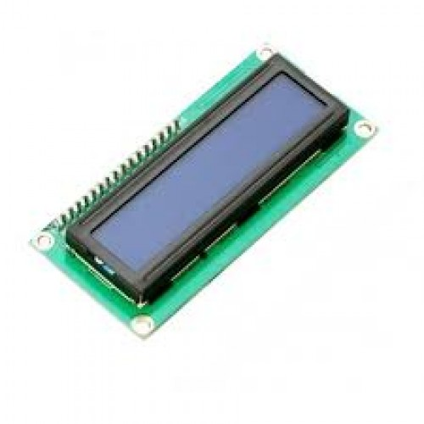
COMPONENTS USED
LCD display
Connecting chords
DC motor
Voltage regulator
Relay
Buzzer
Capacitor
Resistor
LED
Alcohol sensor – (MQ-3 gas sensor)
Transistor
Arduino board

Slide 5
EXPLANATION OF COMPONENTS
ALCOHOL SENSOR:
The alcohol sensor circuit will detect the alcohol depends on the human breath and the signal will send data to the Arduino board. the result of the alcohol content will be displayed on the LCD display.
ARDUINO BOARD:
Arduino is an open-source electronics platform based on easy-to-use hardware and software. Arduino boards are able to read inputs - light on a sensor, a finger on a button, or a Twitter message - and turn it into an output - activating a motor, turning on an LED, publishing something online.
VOLTAGE REGULATOR:
Voltage regulator is designed to automatically maintain a constant voltage level.

Slide 6
EXPLANATION OF COMPONENTS
LCD display:
One glass plate has the 7 segment electrodes etched on it and the conductive coating of tin oxide. LCD display is used to display the amount of alcohol consumed by the driver.
RELAY:
It is an electrical switch that opens and closes under control of another electrical circuit.
BUZZER:
Buzzer is an audio signal device, that is used to buzz when the alcohol concentration is above threshold level
DC motor:
DC motor converts direct current electrical power into mechanical power.it starts rotating when the alcohol concentration is above threshold level.

Slide 7
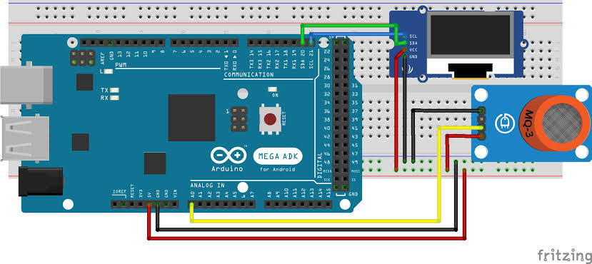
CONNECTION DIAGRAM

Slide 8

Applications
Confirmation of wearing helmet
Blood alcohol concentration detection
Accident intimation
Industrial alcohol gas sensor
Fire safety in hotels and bar

Slide 9
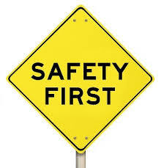
advantages
The most important advantage of an alcohol detector in vehicle system is to:
Reduces accidents
Ensures safety for human lives
Prevents people from drunken driving

Slide 10
FUTURE DEVELOPMENT
Wireless is the buzz of communication industry today. The field of wireless communication is growing leaps and bounds day to day. There have been many advancements taking place in the semi conductor industry leading to more and more advancements in wireless technology.

Slide 11
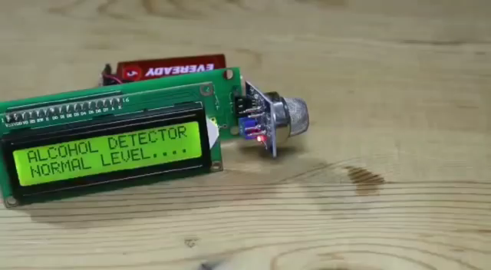
BASIC PROTOTYPE OF THE MODEL

Slide 12
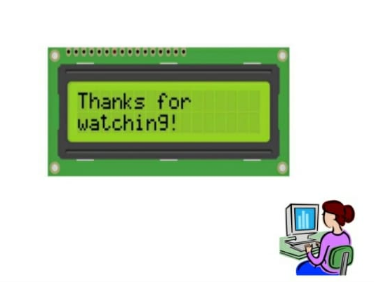
“Design is not how it looks like and feels like. Design is how it works”
- Steve Jobs

